Slide 1

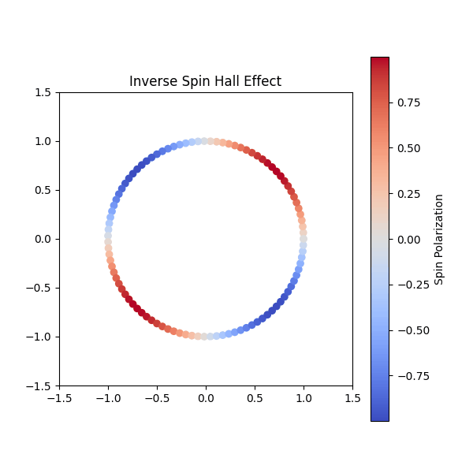
Spin Orbit Interaction
Raj Gaurav Tripathi
DPS
May, 2025

Slide 2
Spin-Direction-Spin Coupling of Quasiguided Modes in Plasmonic Crystals
Jeeban Kumar Nayak¹*, Harley Suchiang¹, Subir Kumar Ray¹, Shyamal Guchhait¹, Ayan Banerjee¹, Subhasish Dutta Gupta¹², and Nirmalya Ghosh¹²
¹ Department of Physical Sciences, Indian Institute of Science Education and Research Kolkata, Mohanpur, India, 741246 ² Tata Centre for Interdisciplinary Sciences, TIFRH, Hyderabad 500107, India
Raj Gaurav Tripathi
Department of Physical Sciences
IISER Kolkata
Date: May 27, 2025

Slide 3
What's Coming..
Spin Orbit Coupling in electron.
Plasmonic Photonic Crystal
Angular Momentum of light
Guided Modes
Darkfield Microscopy S
Spin Orbit Interaction of light
Fano Resonance Spectrum
Geometric phases of light
Photonic Spin Hall Effects
Spin to Orbit Conversion
Forward Spin Hall Effect
Inverse Spin Hall Effect
Theoritical Validation
Achievements and Applications

Slide 4
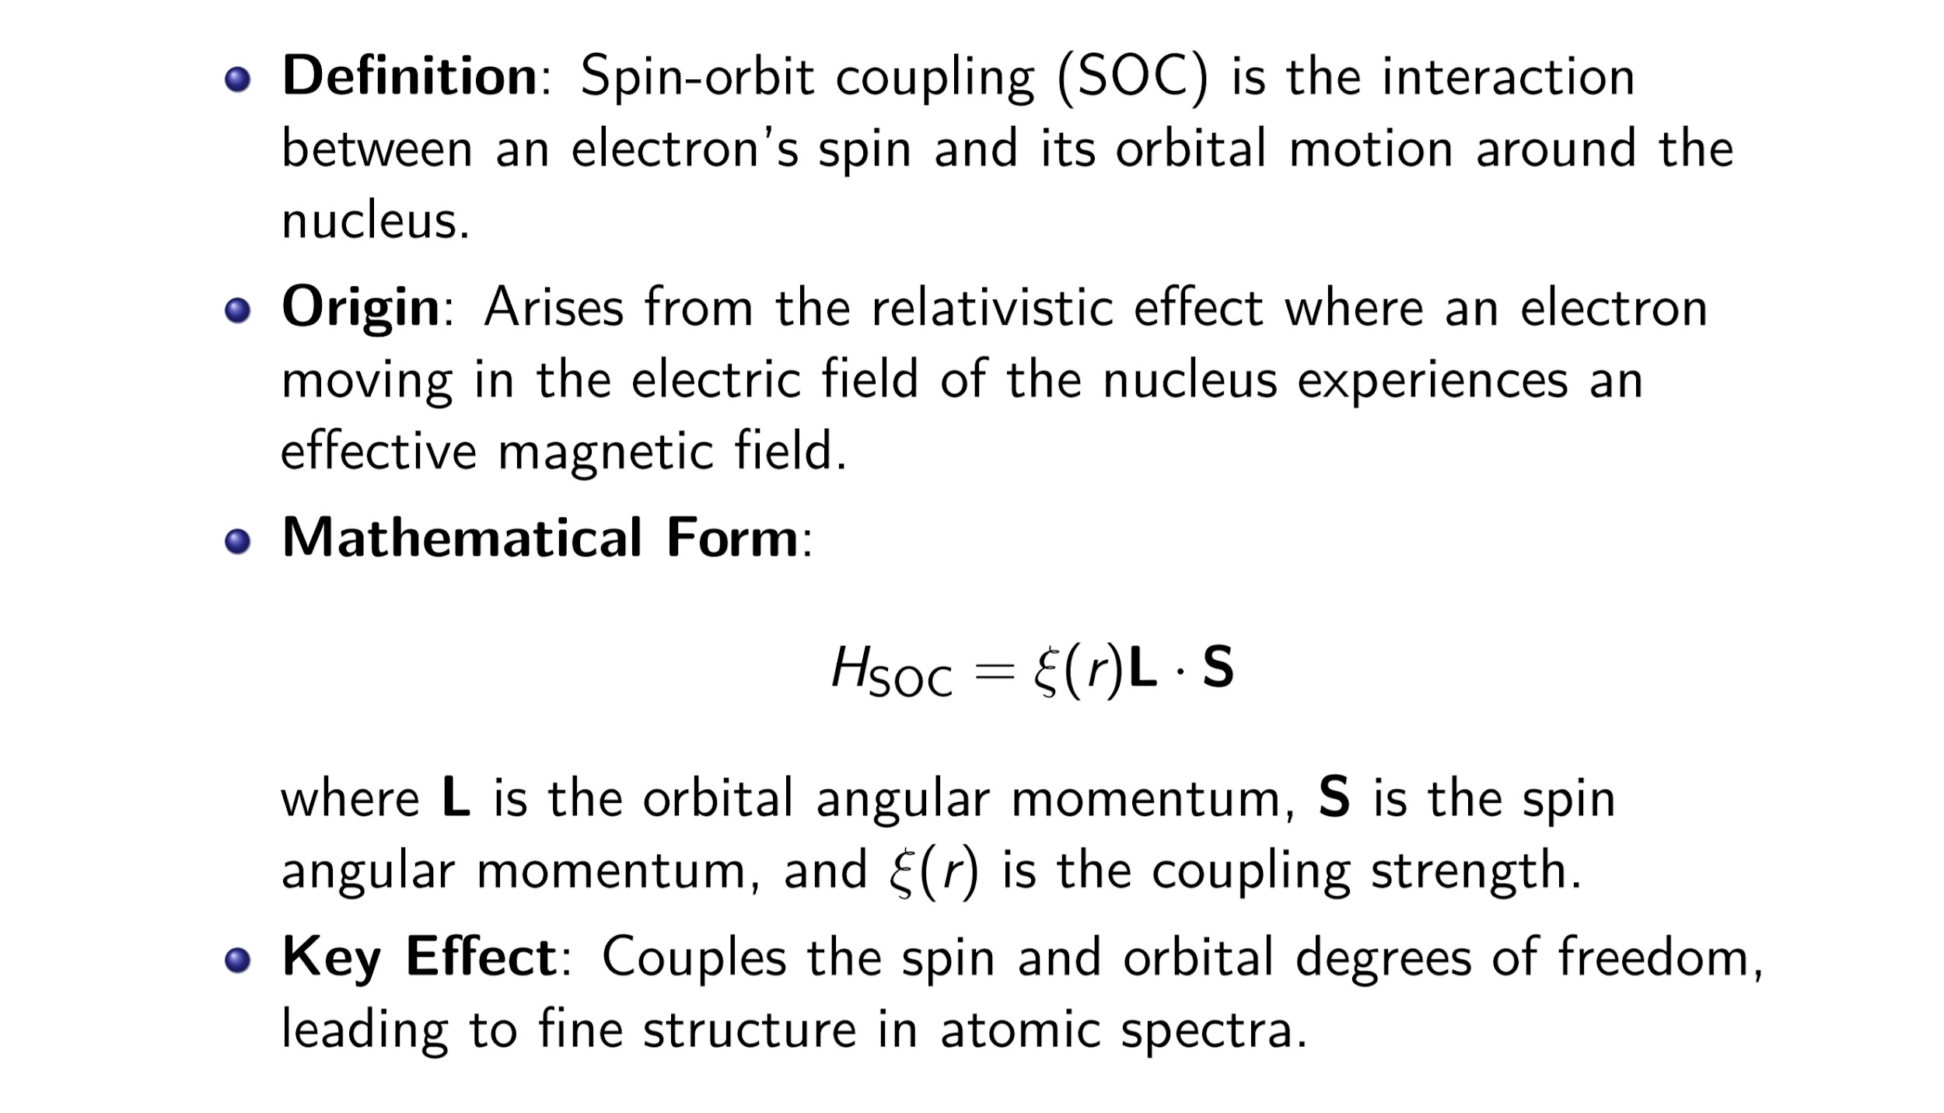
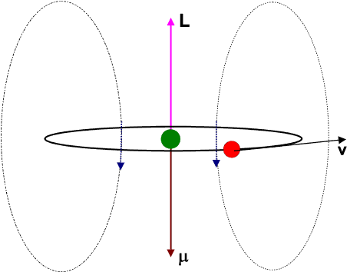
Spin Orbit Interaction of electron

Slide 5
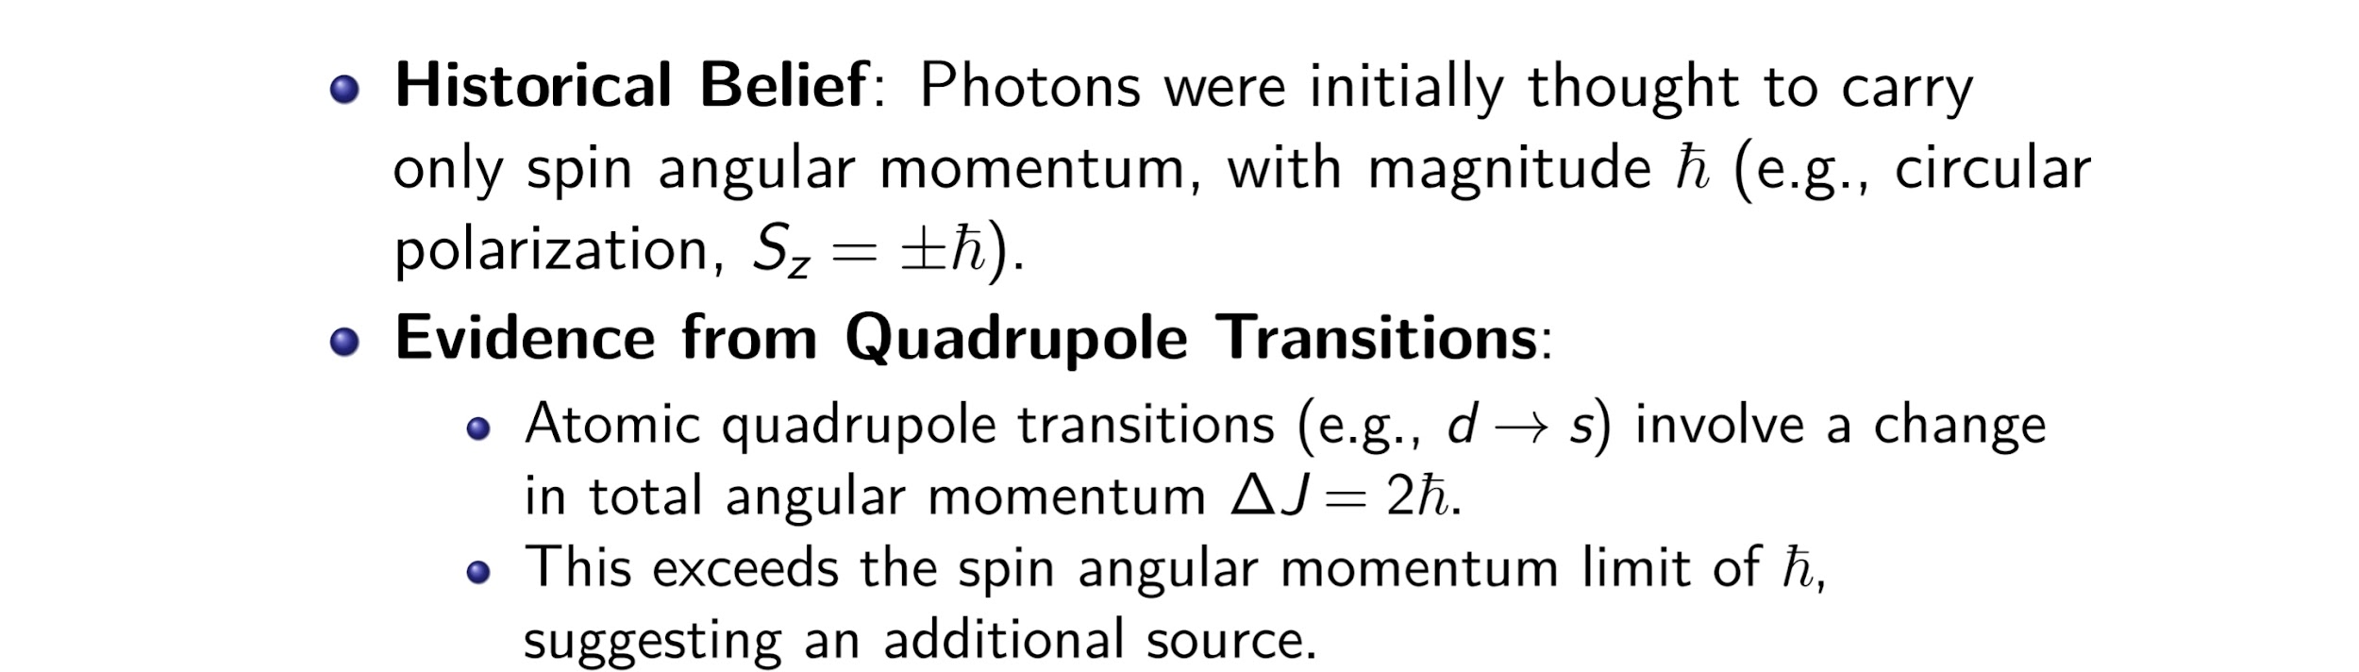
Light as a photon

Slide 6
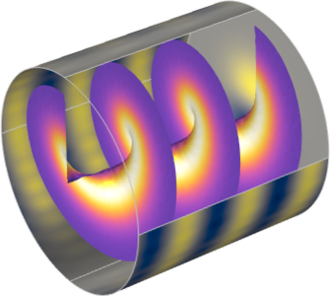
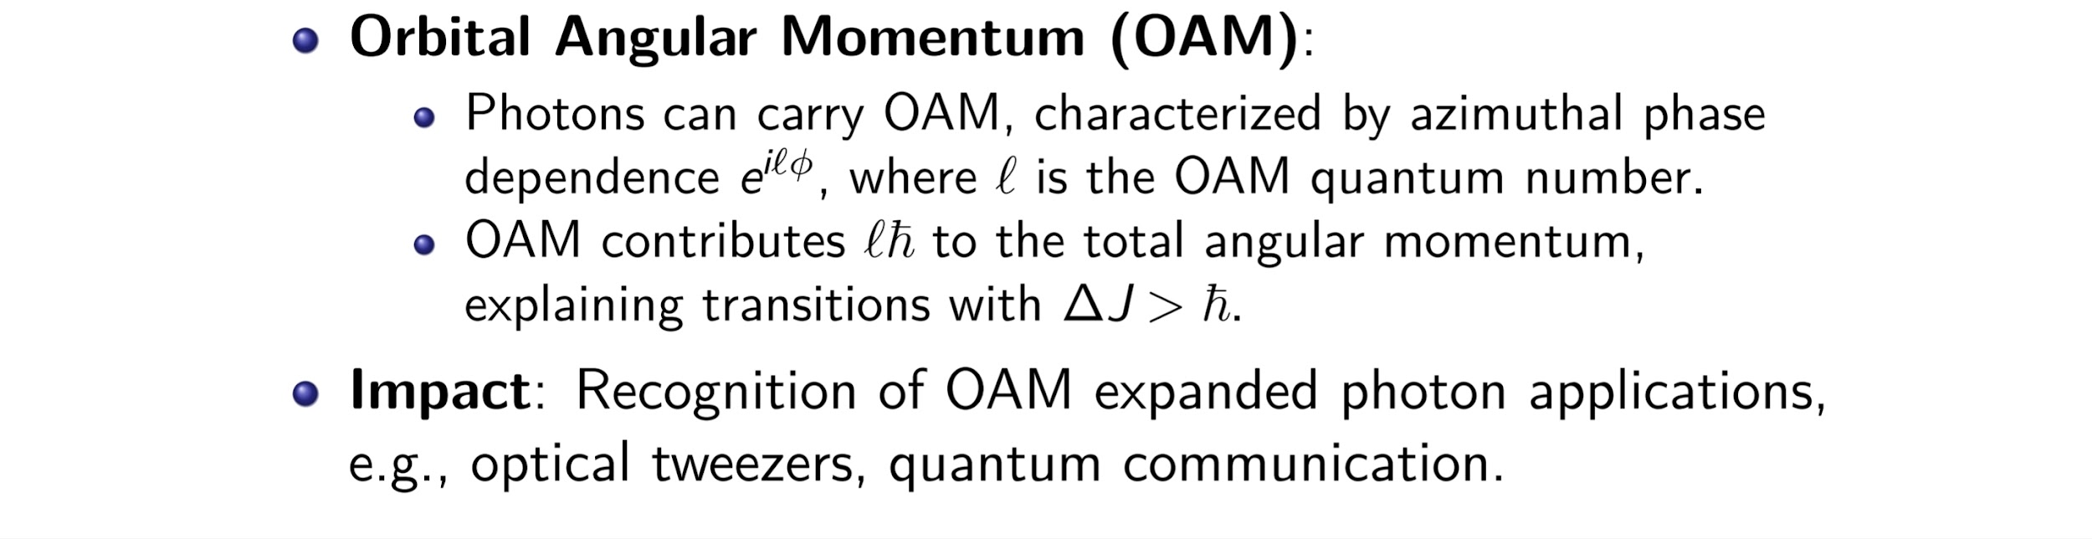
Orbital Angular momentum

Slide 7
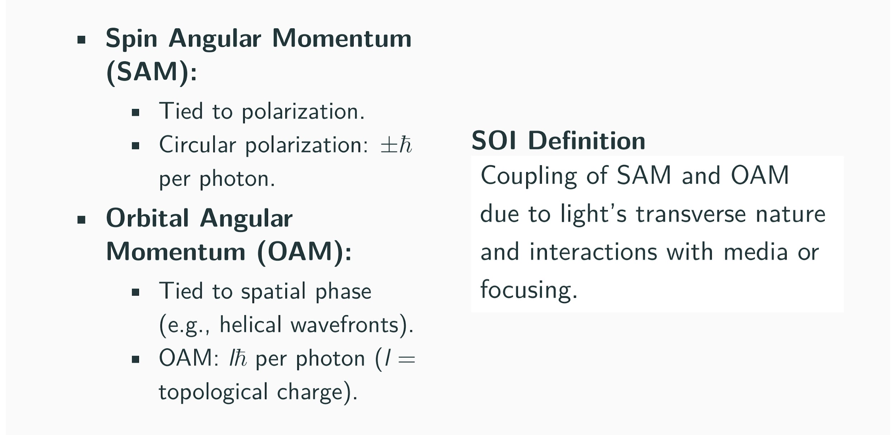
Spin and Orbital Angular Momentum.

Slide 8
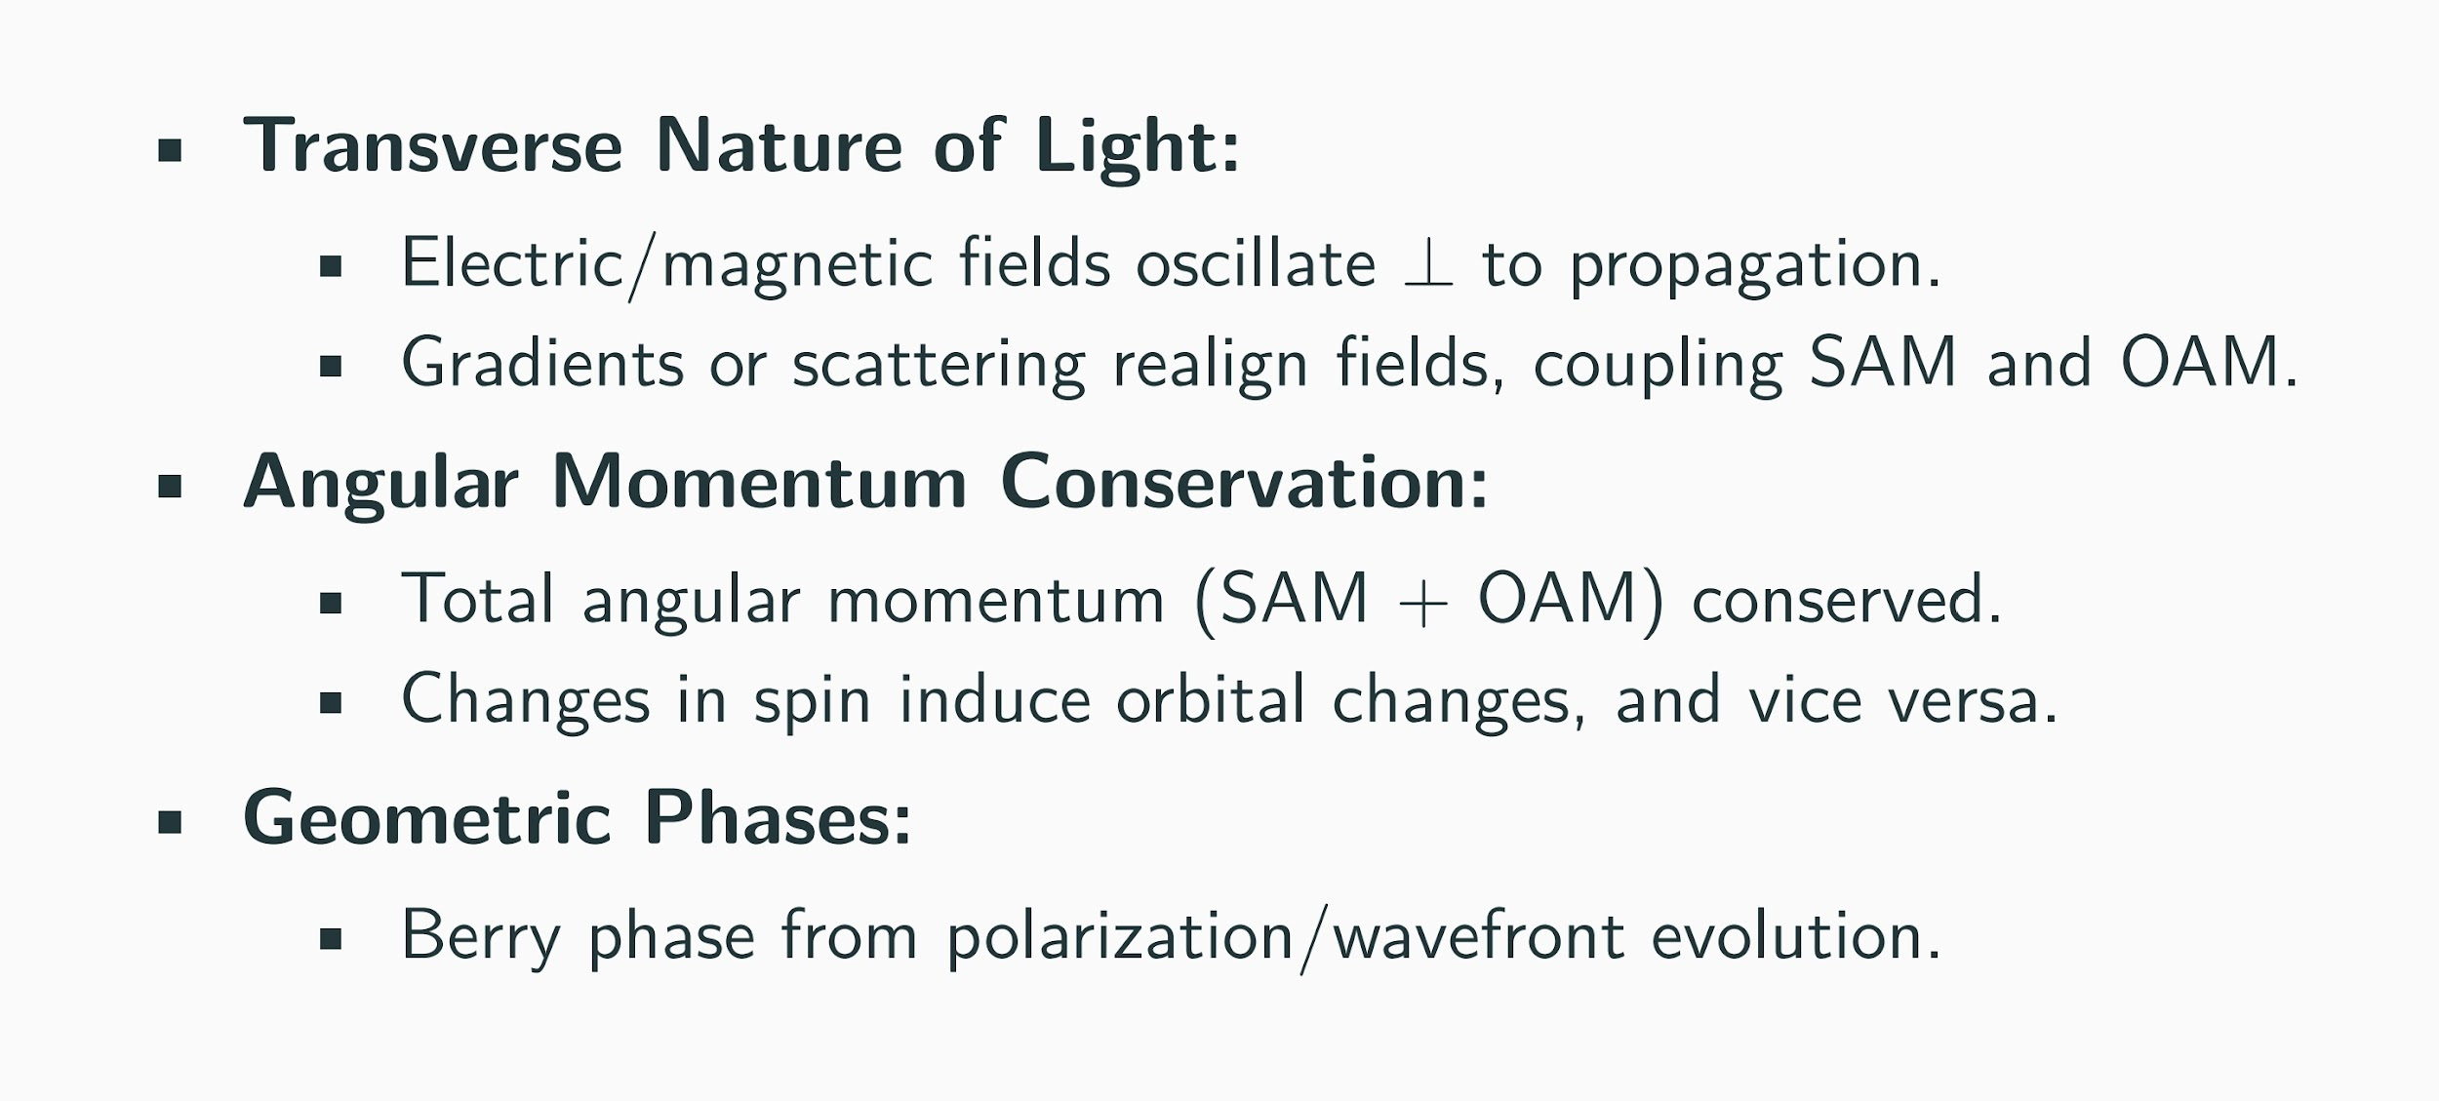
Why SOI?

Slide 9
Types of Geometric phases
Spin-Orbit Interaction (SOI) couples light's polarization (spin) and spatial structure (orbit).
Leads to geometric phases in various scenarios:
Beam redirection
Polarization cycling
Mode transformations
Optical media, scattering, focusing

Slide 10
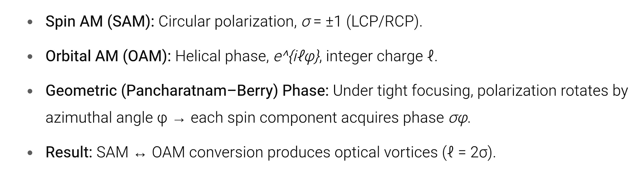
Spin–Orbit Interaction of Light

Slide 11
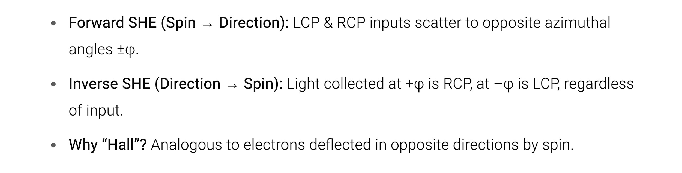
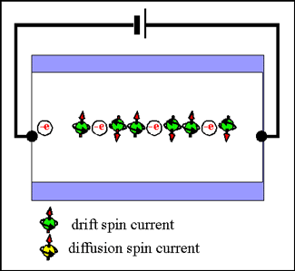
Photonic Spin Hall Effects
Spin Hall effect of electron.

Slide 12
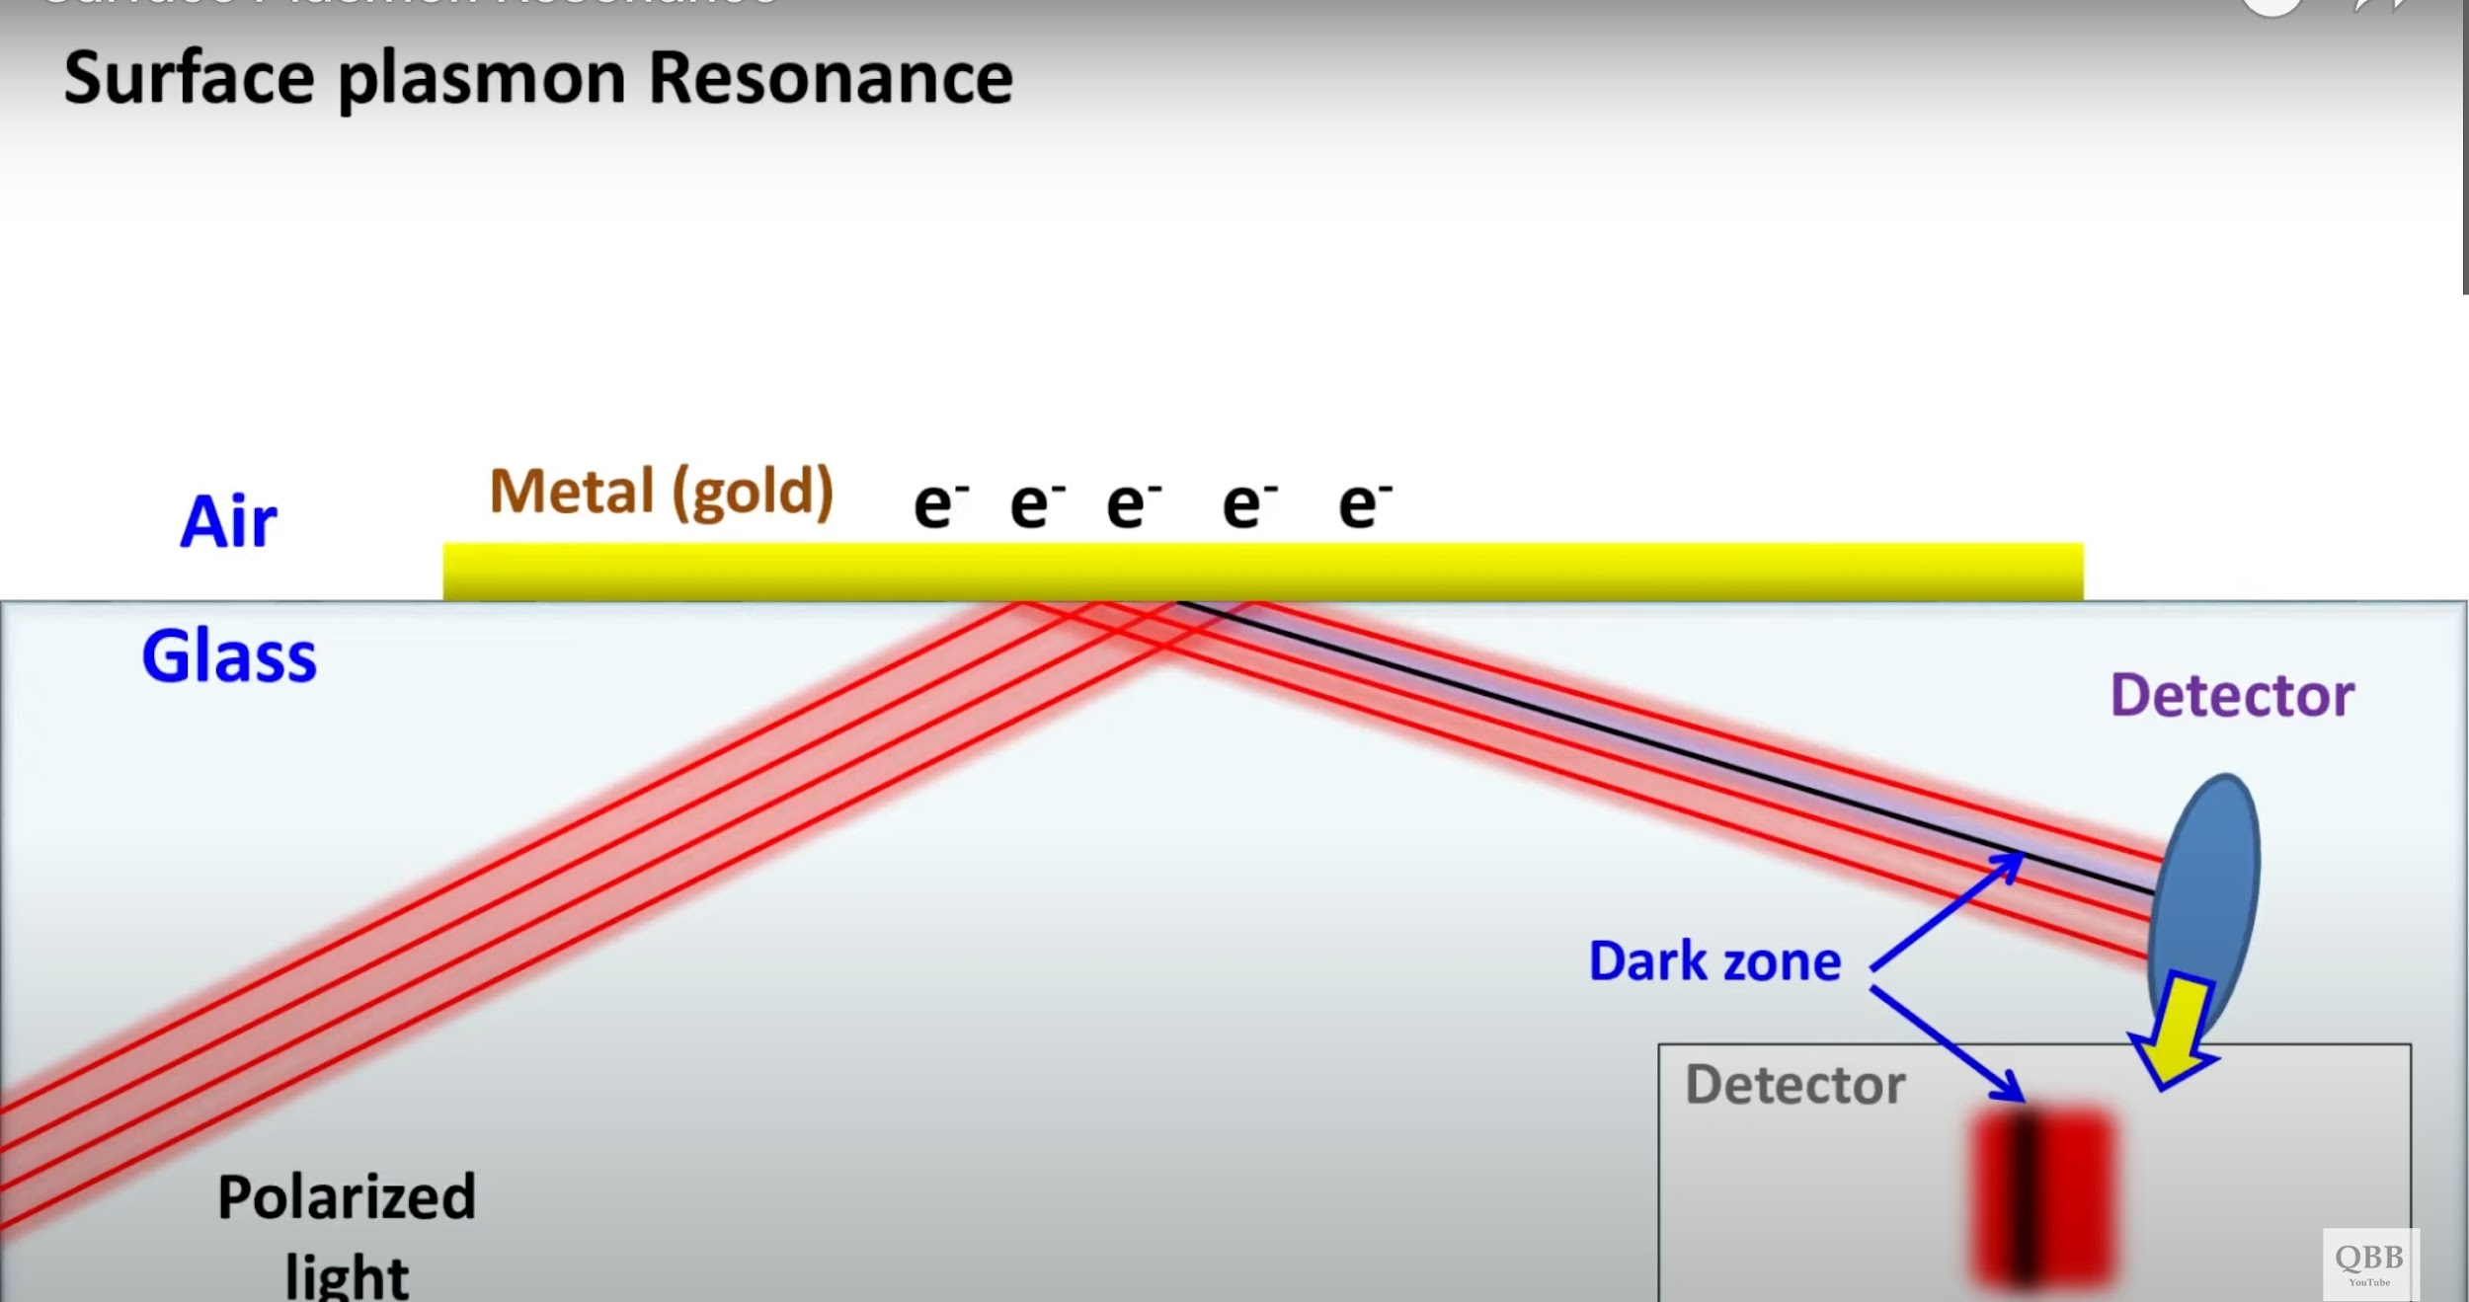
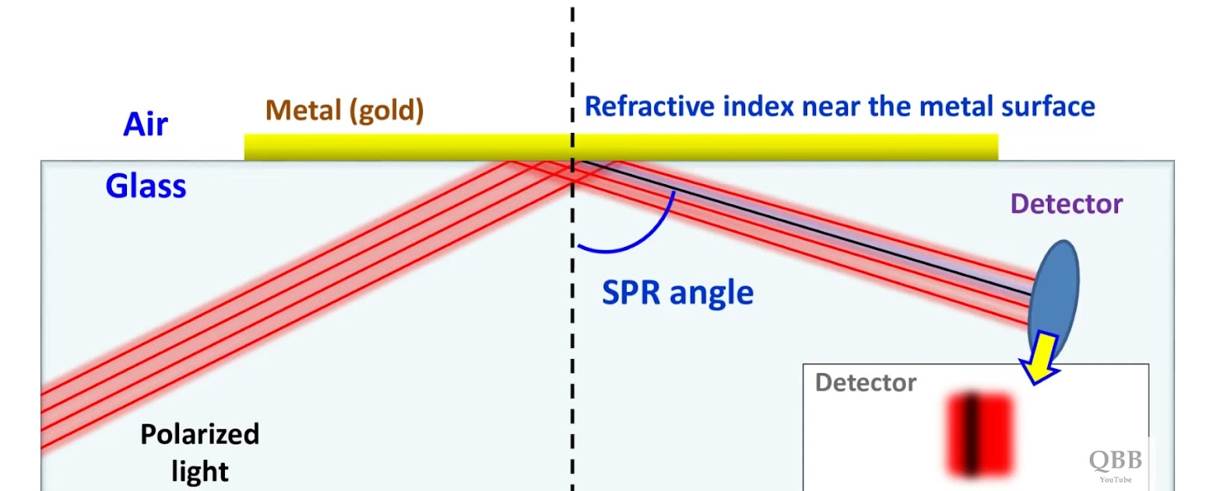
Plasmonic Photonic Crystal
A plasmonic crystal is a periodic structure, typically made of metallic nanoparticles or nano-holes, that exhibits surface plasmon polariton (SPP) modes. These SPPs are collective oscillations of electrons at the interface between a metal and a dielectric,
SSP can be manipulated by the periodic structure of the crystal.

Slide 13
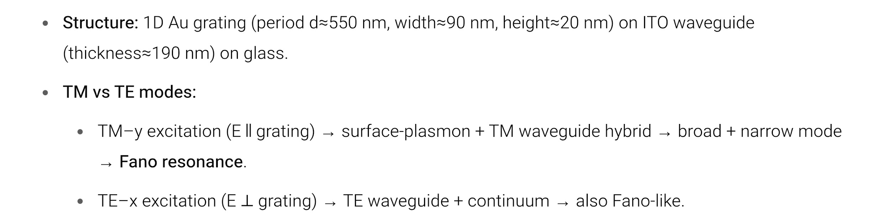
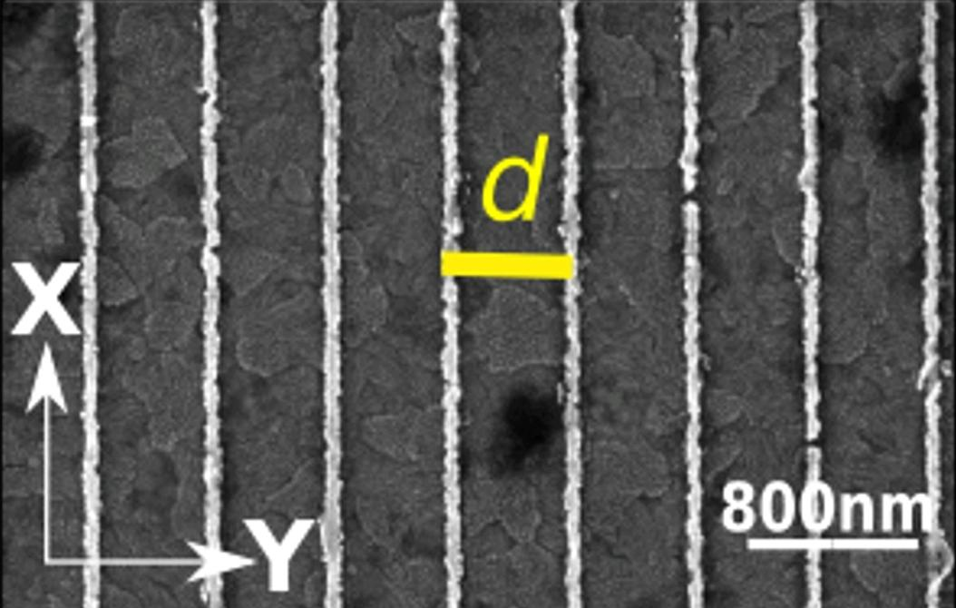
Plasmonic Photonic Crystal
Typical SEM images of the Au grating waveguided plasmonic crystal. The direction of the TM-y and TE-x polarizations are shown.

Slide 14
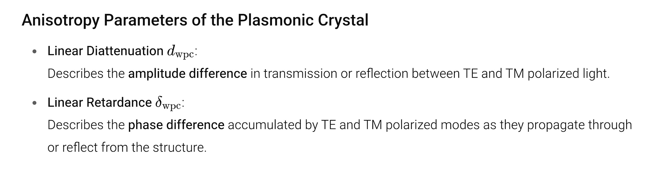
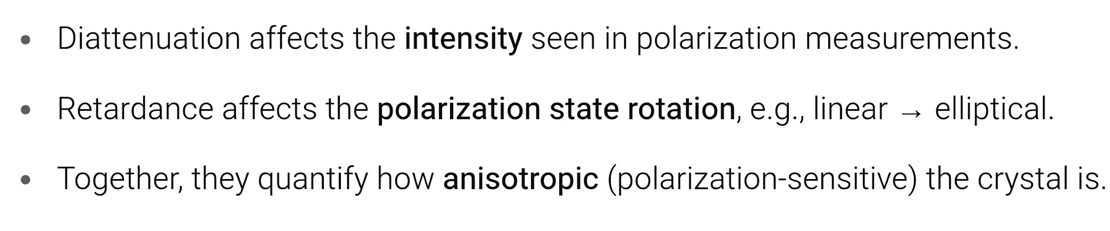
Plasmonic Photonic Crystal

Slide 15
Guided modes
In a dielectric waveguide, light can be trapped and guided along the plane due to total internal reflection, so they do not radiate out — they're bound modes..
When the perfect symmetry of the waveguide is disturbed — e.g., by adding a grating, metal, or finite thickness — the guided modes become “quasi”-guided.That means:
The light is still mostly guided in-plane.
But due to structural features, a small amount leaks into free space.
Leaky quasiguided modes are partially confined optical modes in a structured waveguide system that radiate weakly into free space, enabling direct observation of spin-dependent effects in the far field.

Slide 16
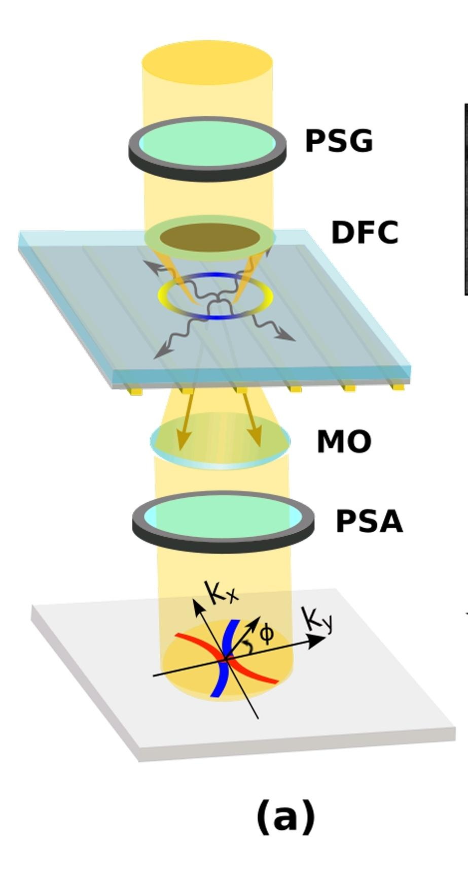
Dark Field Microscopy
optical imaging technique used to observe weakly scattering objects by blocking direct light and only collecting light scattered by the sample.
In brightfield microscopy, light passes directly through or reflects off the sample and into the objective.
➤ Bright background, often overwhelms weak scatterers.
In darkfield microscopy, the central (unscattered) light is blocked, and only scattered light enters the objective lens.
A schematic of the darkfield Fourier domain polarization Mueller matrix microscopy system. PSG and PSA: Polarization state generator and analyzer units, DFC: Darkfield condenser, MO: Microscope objective.

Slide 17
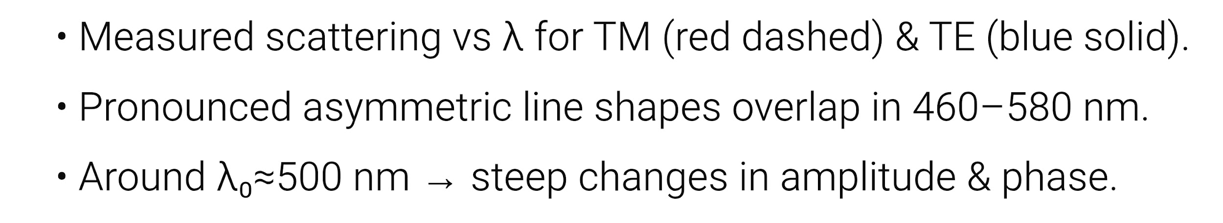
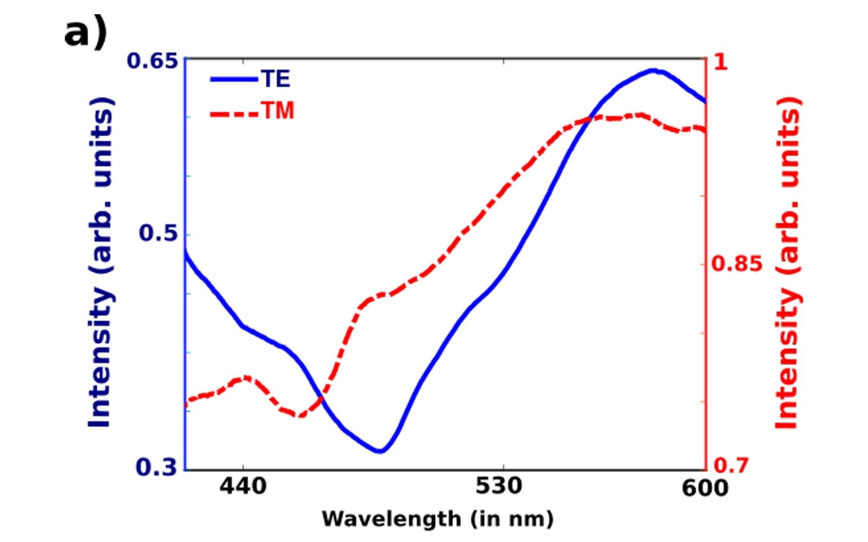
Fano Resonance Spectrum

Slide 18
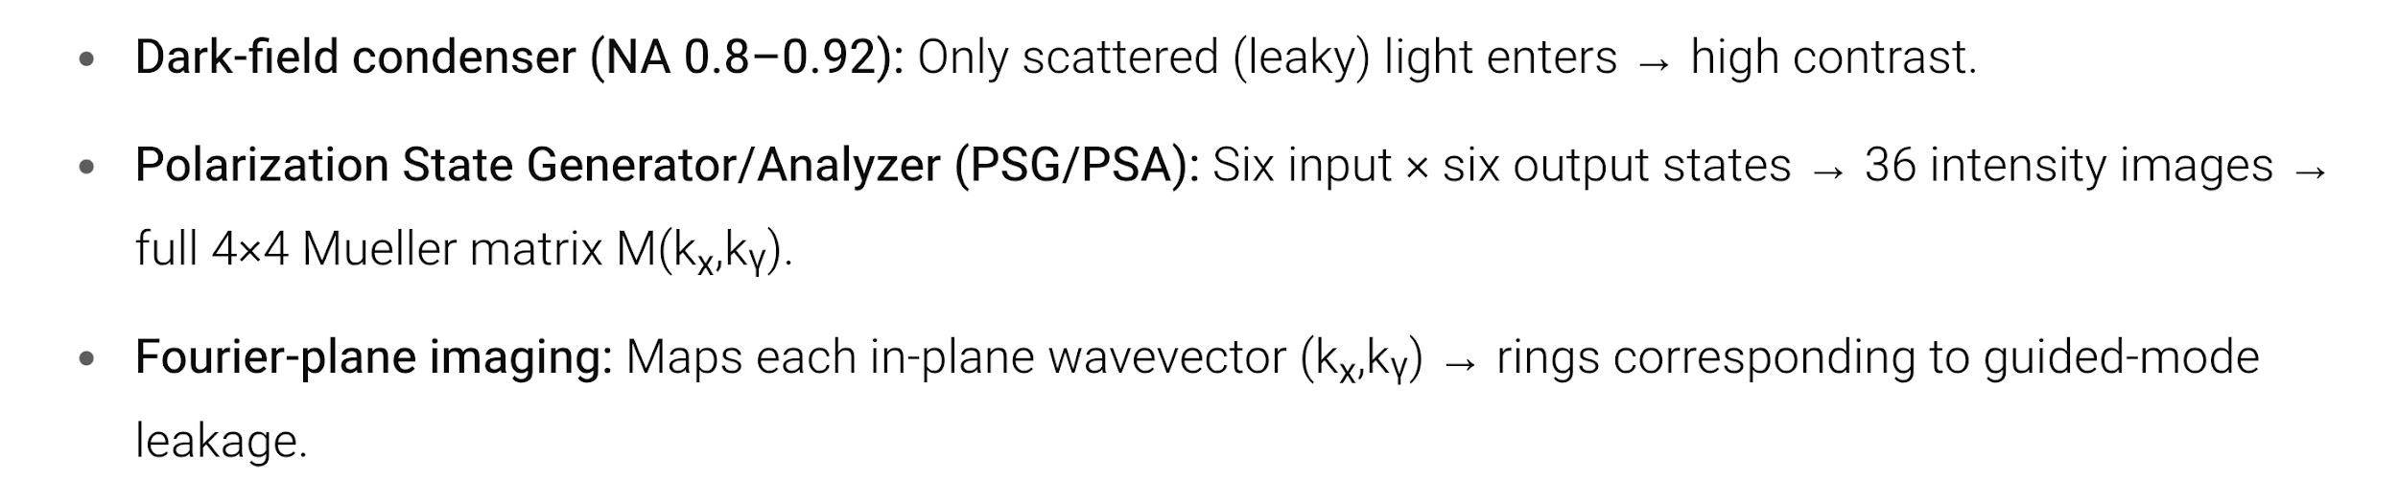
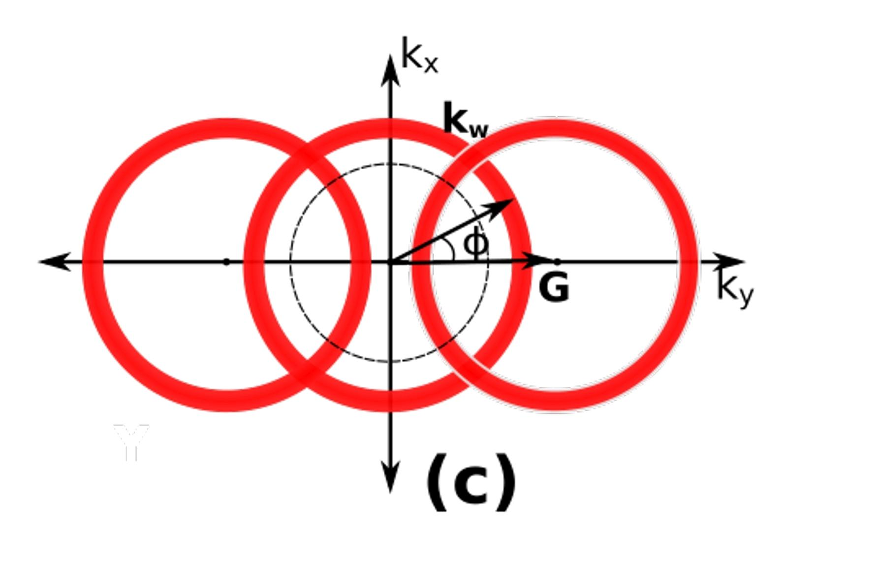
Dark-Field Fourier-Domain Mueller Microscopy
The leakage radiation of the quasiguided modes manifest as ring-like intensity distribution in the momentum (k) domain

Slide 19
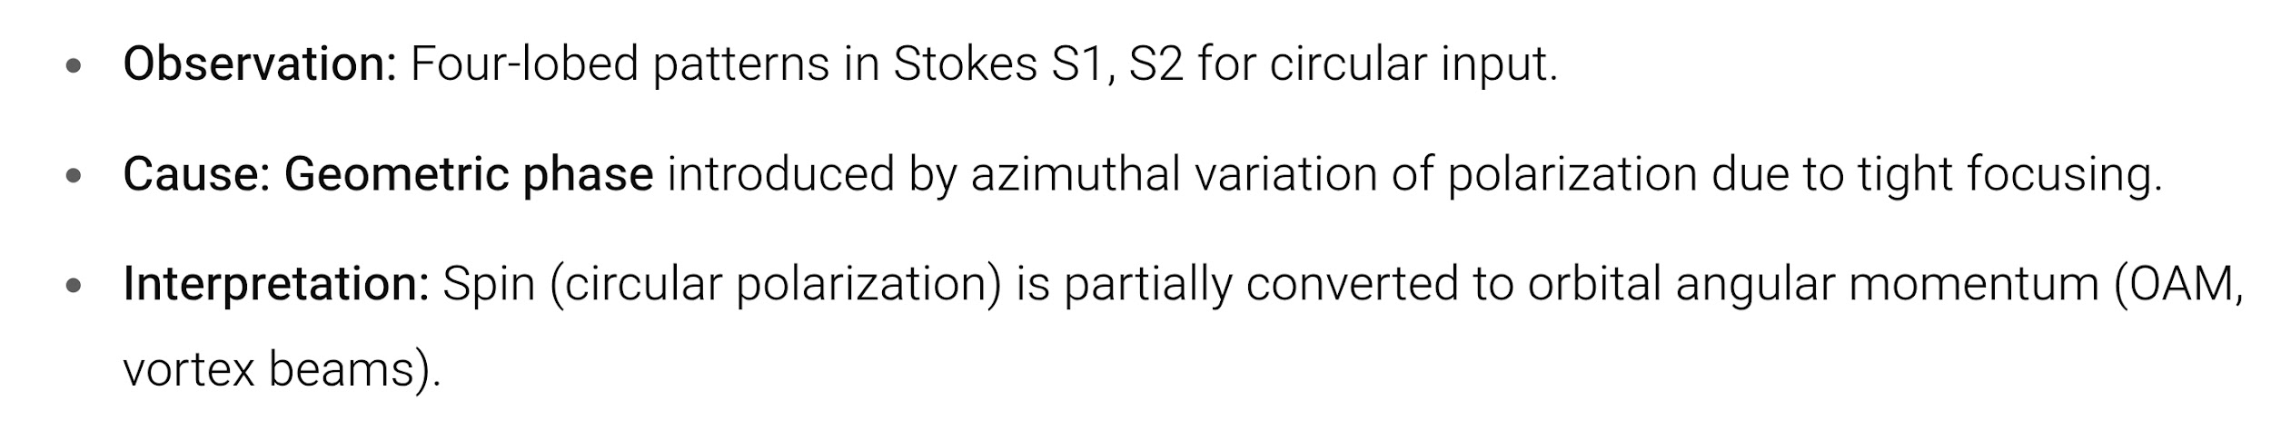
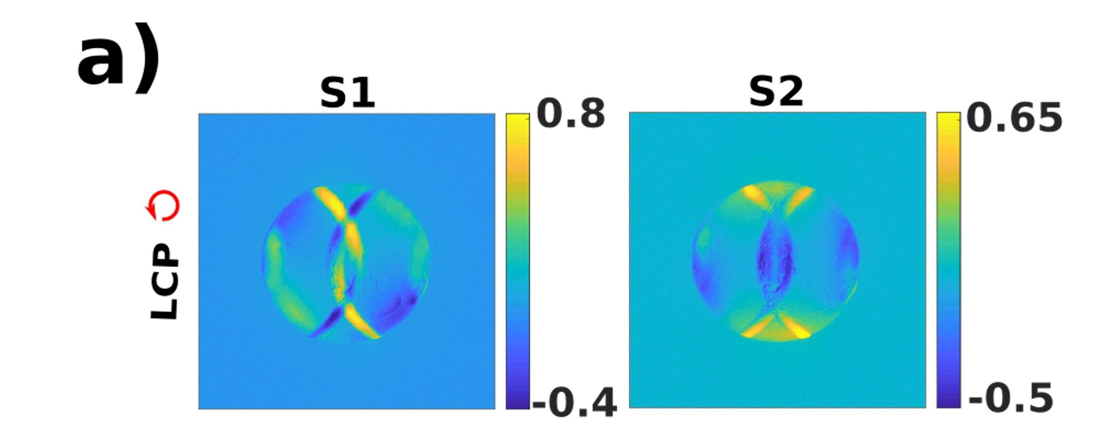
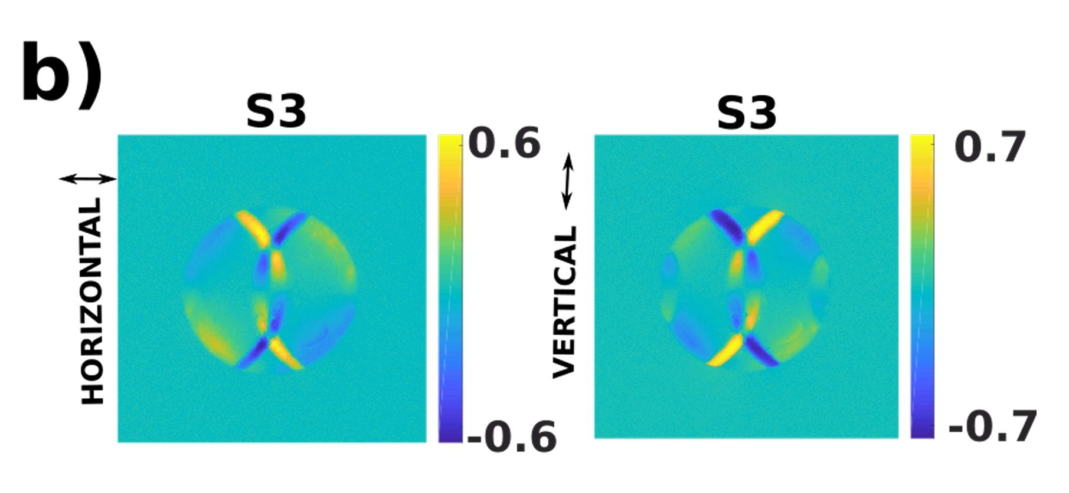
Spin to Orbit Conversion
Signature of the SAM to IOAM conversion through azimuthal geometric phase, manifesting as azimuthally varying intensity patterns in the k-space arc segments, (a) in the Stokes vector elements (S1) and (S2) for input LCP state and (b) in the Stokes vector element (S3) for input horizontal and vertical polarization states.

Slide 20
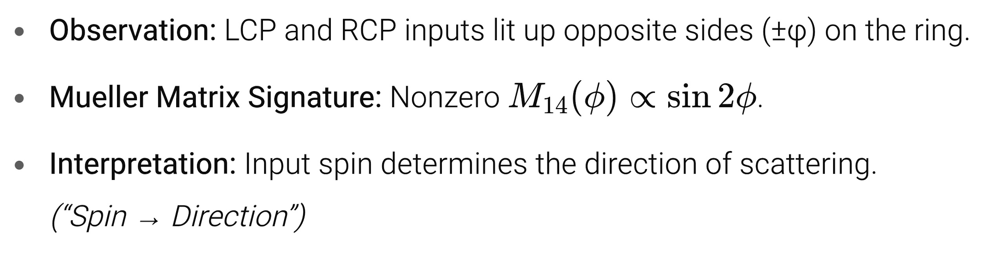
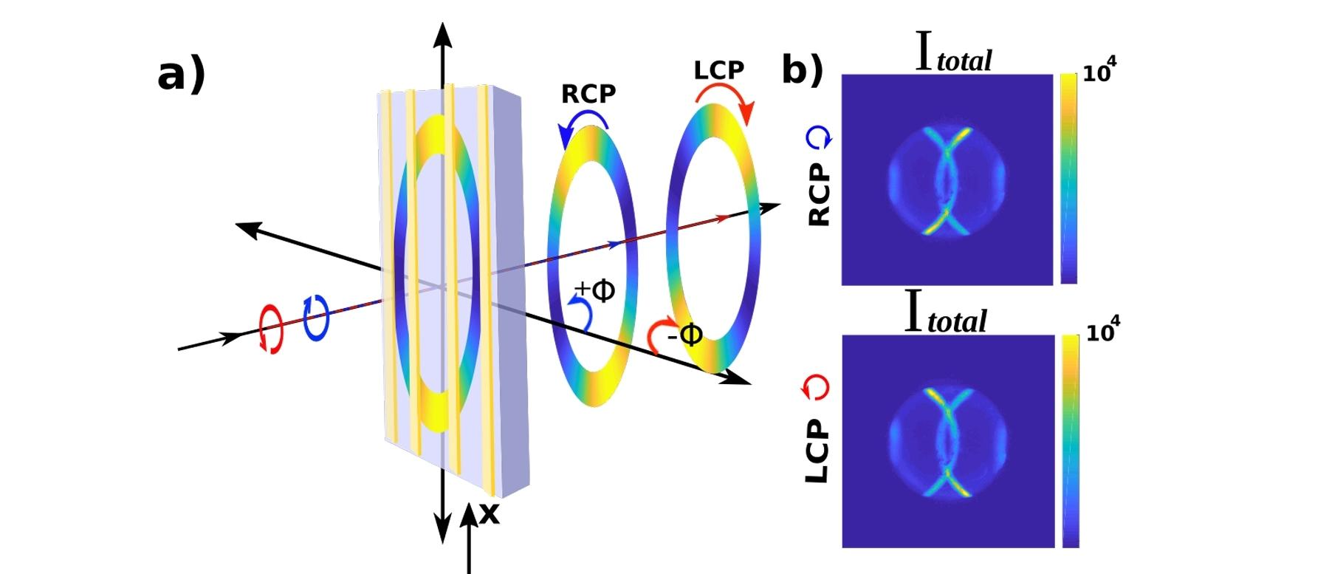
Forward Spin Hall Effect

Slide 21
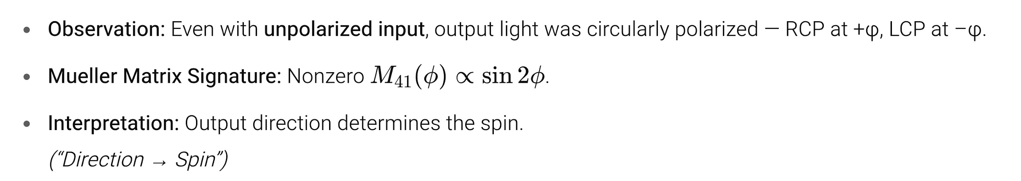
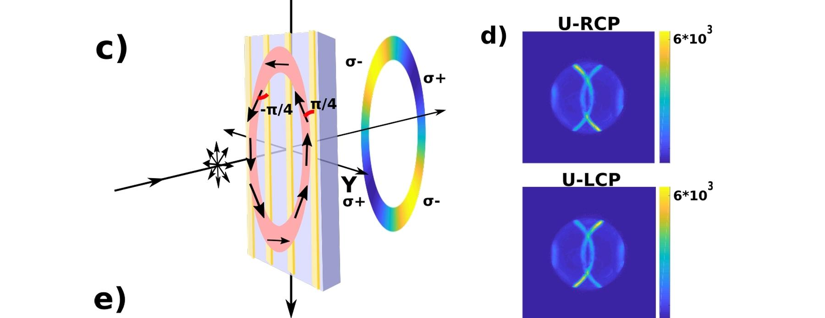
Inverse Spin Hall Effect of Light

Slide 22
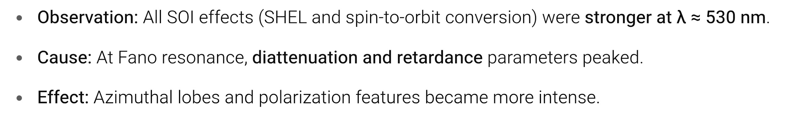
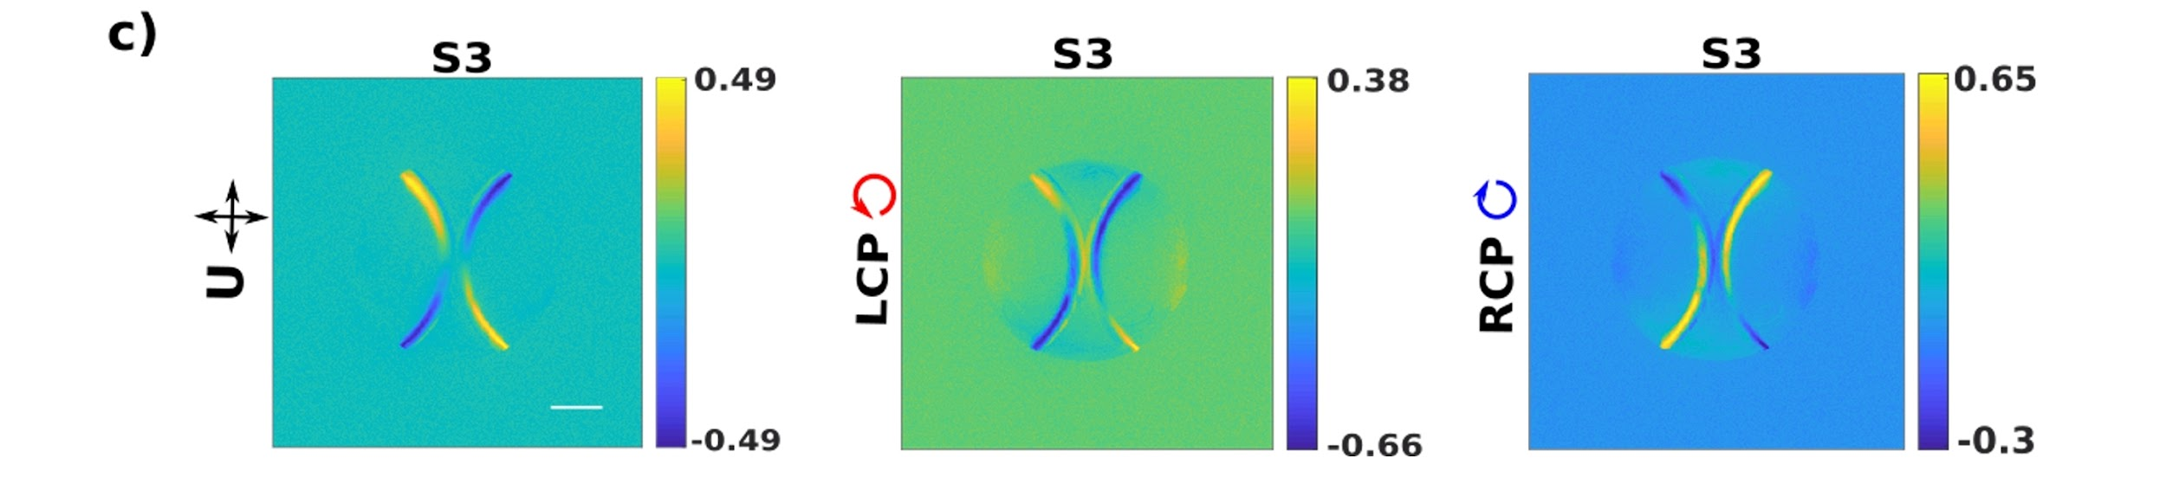
Fano Resonance Enhanced Effects
The Stokes vector element S3 of the k-space arc segments of the leaky quasiguided mode recorded for input unpolarized (U), LCP and RCP light at λ = 530nm demonstrates resonant enhancement of froward and inverse spin Hall effect of light.

Slide 23
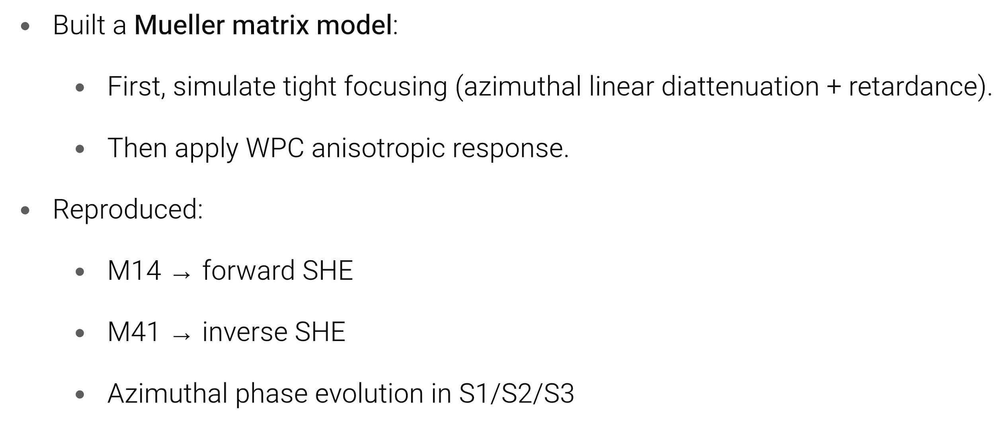
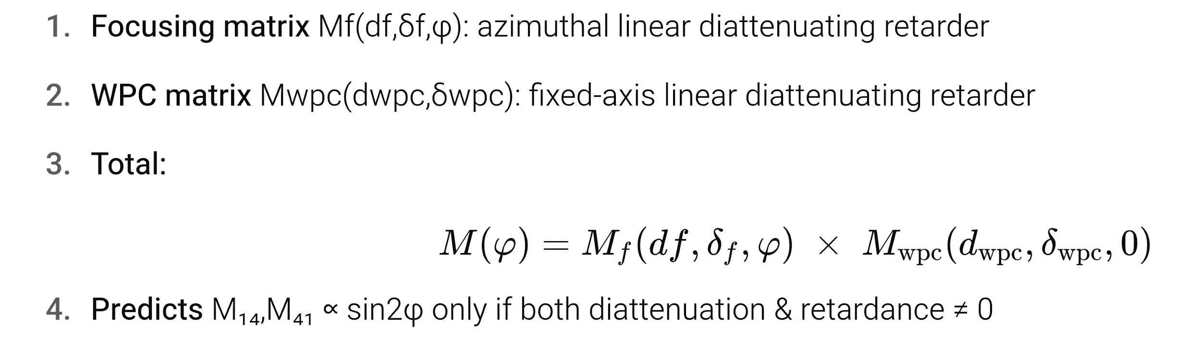
Theoretical Validation

Slide 24
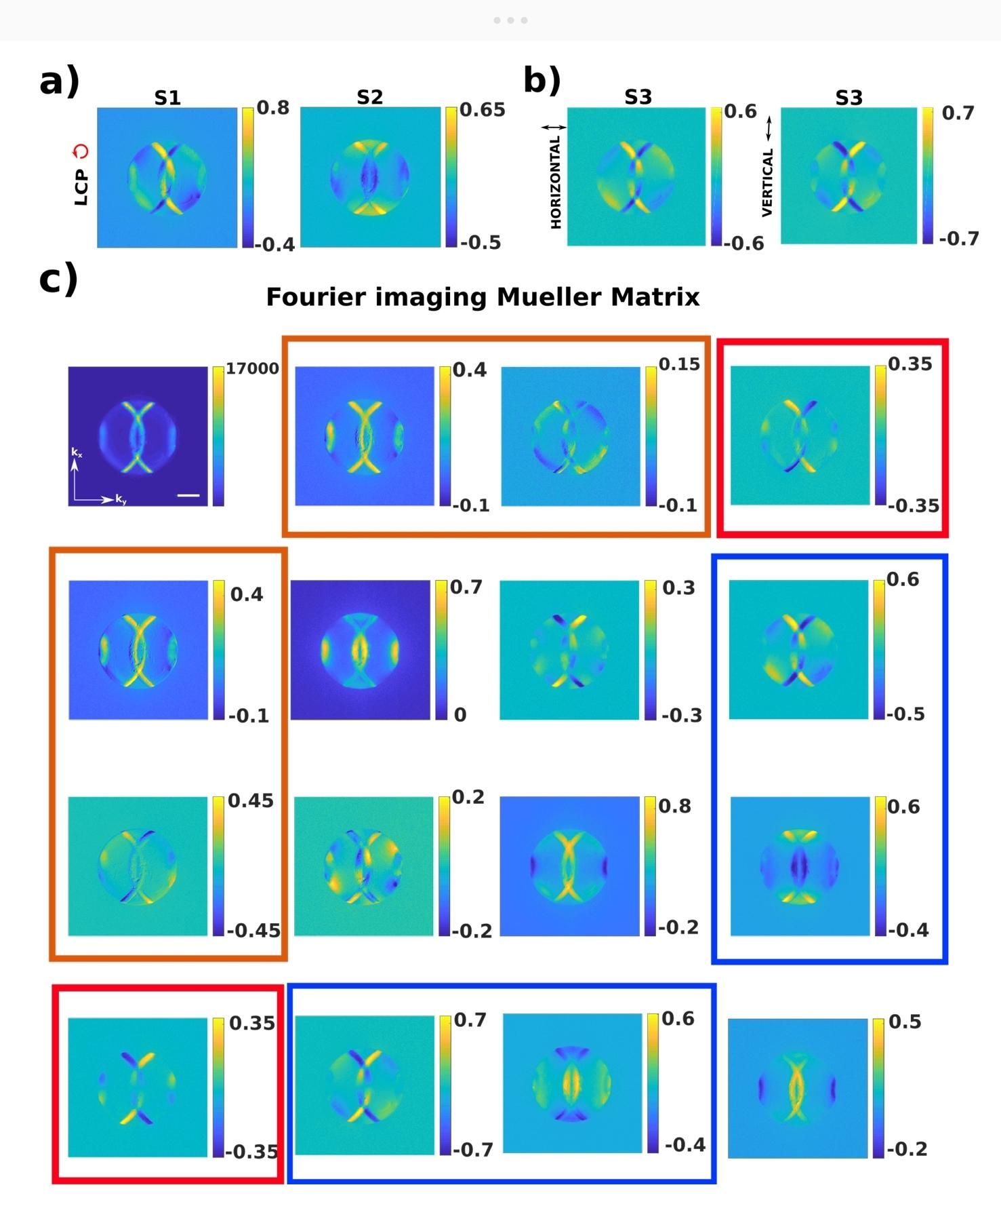
Theoretical Validation
Tight focusing imposes a φ-dependent geometric phase
The grating’s fixed anisotropy selects between TE and TM modes (giving phase and amplitude differences).
Spin to orbital AM conversion of the quasiguided photonic modes of the WPC in the k-space Stokes vectors and Mueller matrix elements.

Slide 25
What we did..
We designed a plasmonic crystal that supports leaky guided modes sensitive to polarization.
We used a darkfield Fourier-domain Mueller matrix microscope to probe scattering in momentum space.
We measured full polarization response (Mueller matrices) for various input polarizations.
We observed spin-to-orbit angular momentum conversion and distinct spin Hall effects.
All effects were enhanced near a Fano resonance, due to strong anisotropic response.

Slide 26
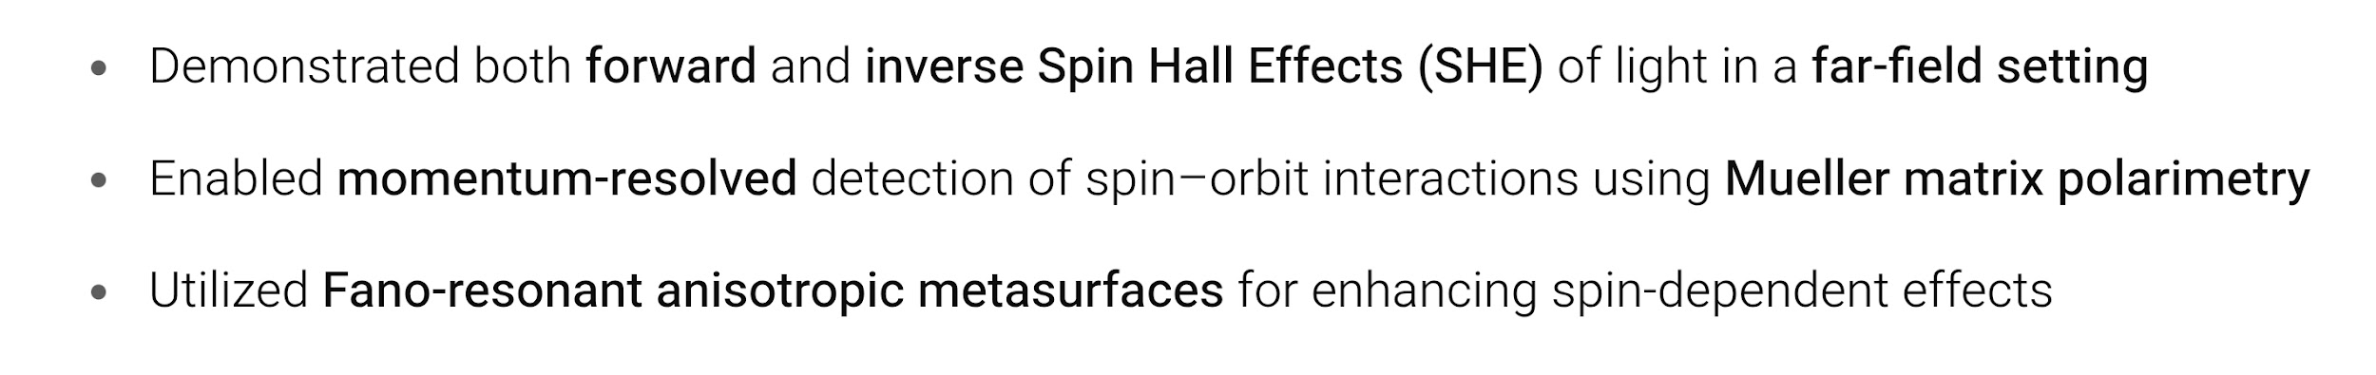
Achievements..

Slide 27
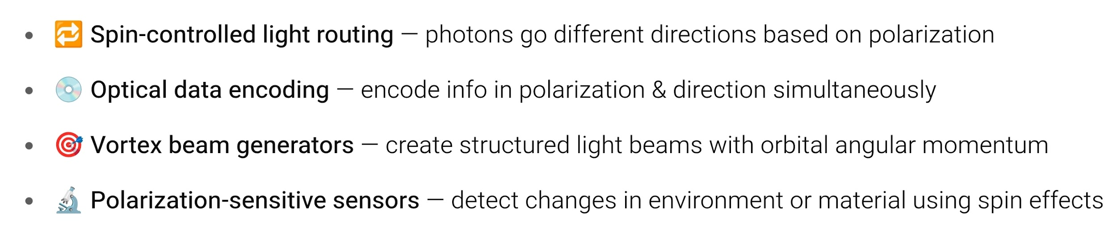
Potential Applications

Slide 28

Thank you..

